Slide 1
Joe’s Real- Time Currency Converter
Project 1 by Youssef Said.

Slide 2
Goals & Objectives
To be able to convert between domestic and foreign currencies in Real-Time.
To be able to view the current top rates in Real-Time.
To be able to view the lowest rates in Real-Time.
Create a CLI that is user friendly.

Slide 3
Implementation goals
Created a class called Joe’s currency converter.
The class has many methods for
Getting data
Slicing data
Using data to preform calculations
Showing tables of rates.

Slide 4
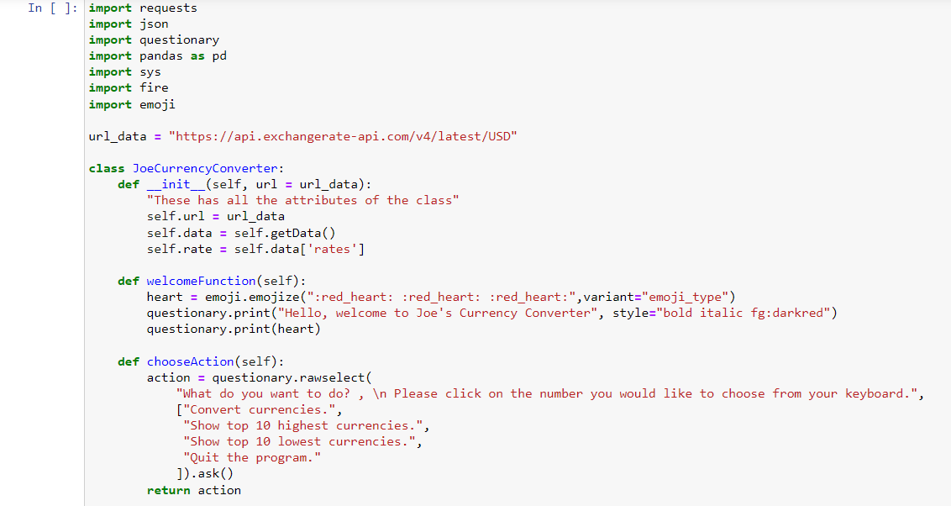
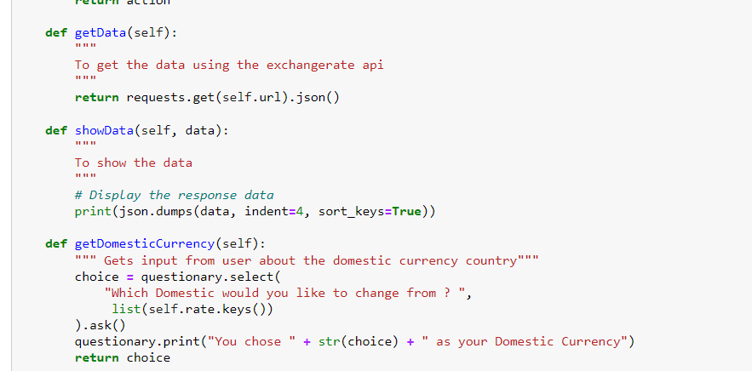
Implementation

Slide 5
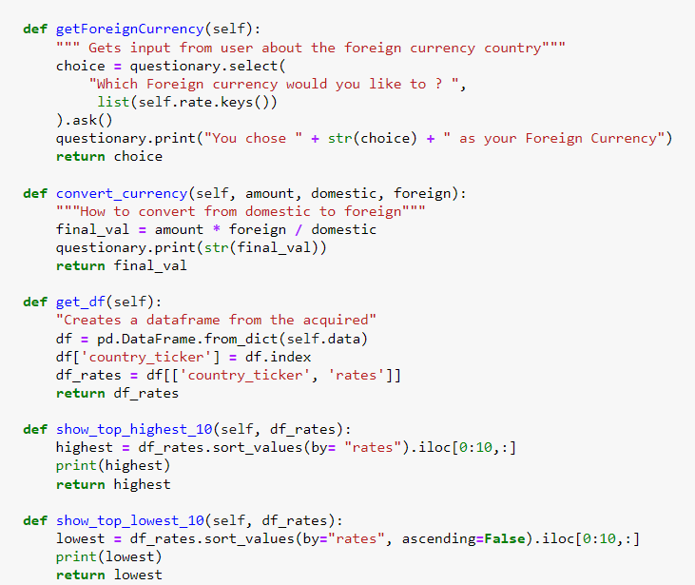
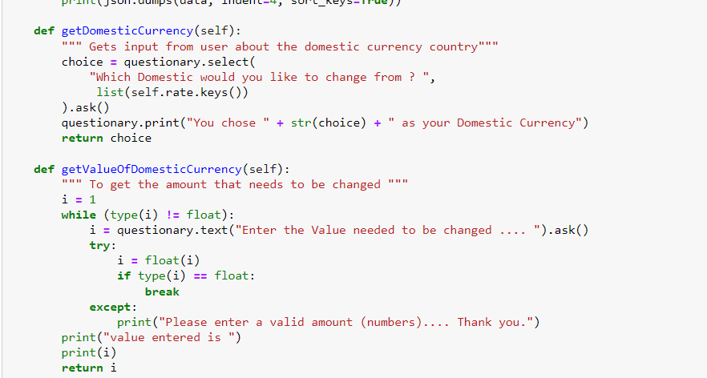

Implementation cont

Slide 6
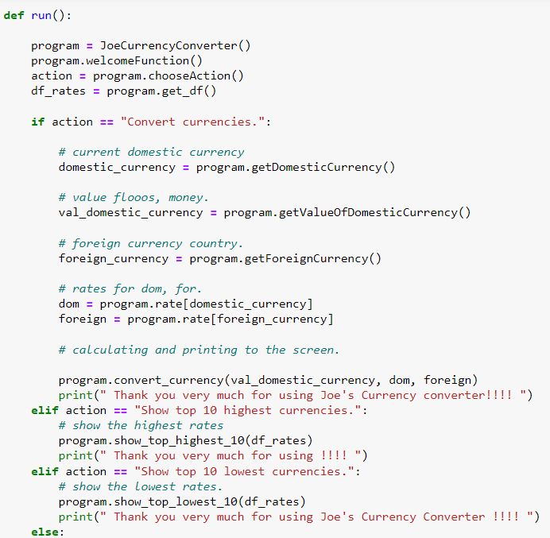
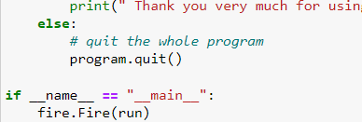
Implementation cont.

Slide 7
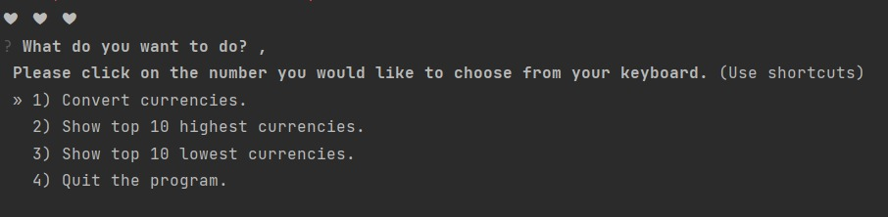
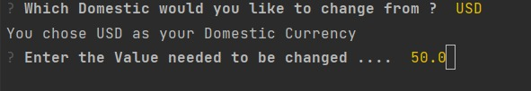
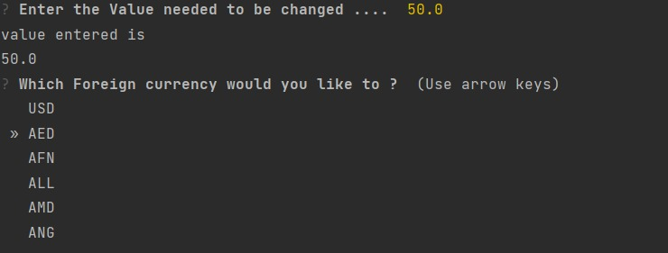
Pictures of the CLI (Command line interface) Currency converter

Slide 8
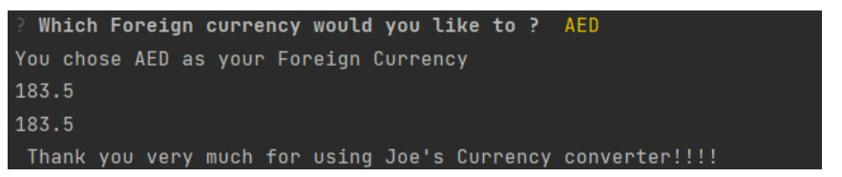
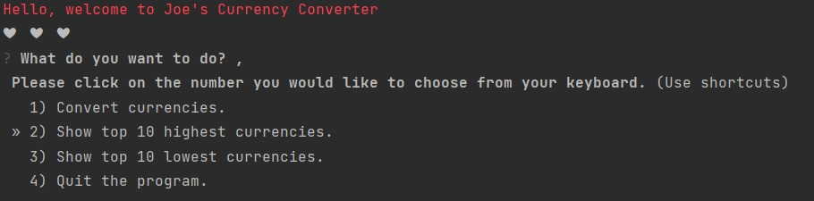
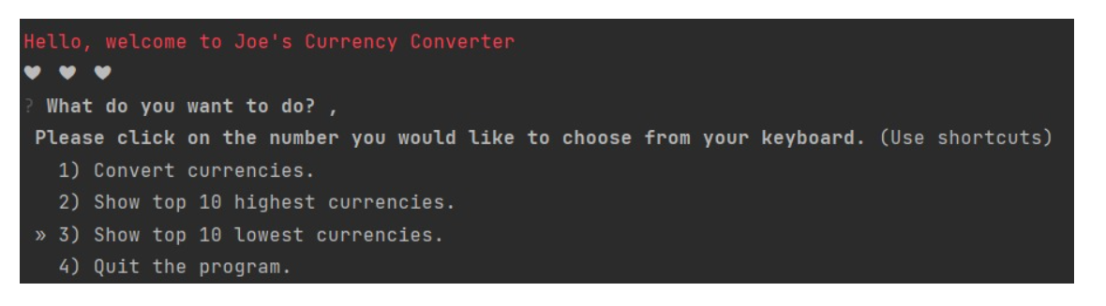
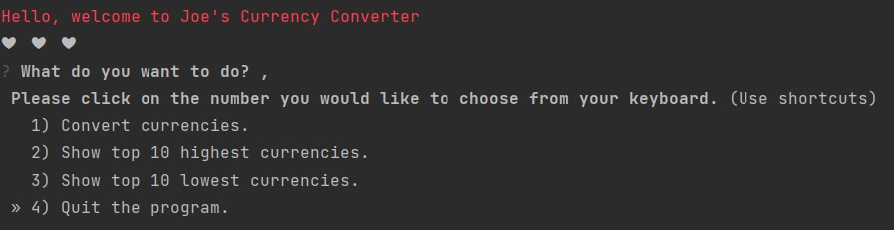
CLI PICS of other options

Slide 9
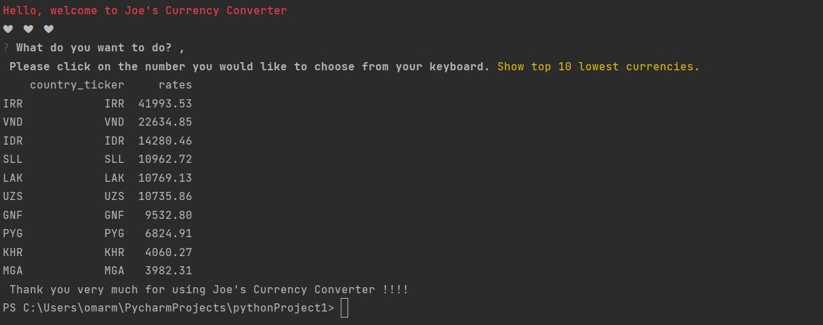
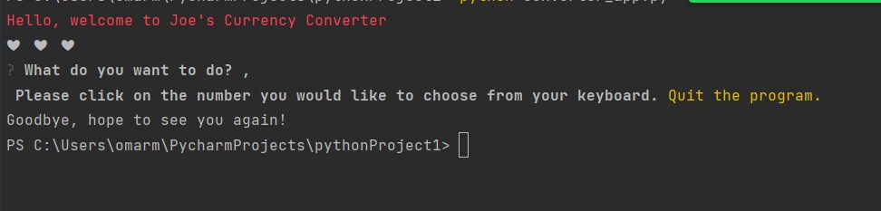
CLI PICS of other options cont.

Slide 10
Thank you

